Slide 1

DIVINE GRACE COLLEGE OF ARTS, SCIENCE AND TECHNOLOGY
(DGCAST) — GAROUA | GEOGRAPHY DEPARTMENT
UPPER SIXTH ARTS — SETTLEMENT GEOGRAPHY — LESSON 12
Current Trends in Urbanisation
Mr KAMDEM EMMANUEL
Geography Teacher — PLEG
Academic Year 2026 / 2027
Notes:
Good morning, class. Today we study Lesson 12: Current Trends in Urbanisation.

Slide 2
GEOGRAPHY — UPPER SIXTH ARTS
CLASS INFO
Class, Chapter & Duration
Class | Upper Sixth Arts
Chapter | Module 5: Understanding and managing settlement dynamics across the world in general and Cameroon in particular
Duration | 2 periods (2 × 50 minutes)
2026 / 2027
DGCAST GAROUA — GEOGRAPHY DEPARTMENT
Mr KAMDEM E. | 2

Slide 3
GEOGRAPHY — UPPER SIXTH ARTS
IDENTIFICATION
Lesson Identification
Topic | Urban Settlement and Urbanisation
Sub-topic | Urbanisation
Lesson | Lesson 12: Current Trends in Urbanisation
Notions / Concepts | Suburbanisation, counter-urbanisation, re-urbanisation, centripetal forces, centrifugal forces, gentrification.
Syllabus focus | Suburbanisation, counter-urbanisation and re-urbanisation: causes and consequences; centripetal and centrifugal forces.
Competence | Learners are able to explain the recent stages of urban change.
2026 / 2027
DGCAST GAROUA — GEOGRAPHY DEPARTMENT
Mr KAMDEM E. | 3

Slide 4
GEOGRAPHY — UPPER SIXTH ARTS
OBJECTIVES
Learning Objectives
By the end of the lesson, the learner should be able to:
Explain suburbanisation.
Explain counter-urbanisation.
Explain re-urbanisation and centripetal and centrifugal forces.
2026 / 2027
DGCAST GAROUA — GEOGRAPHY DEPARTMENT
Mr KAMDEM E. | 4

Slide 5
GEOGRAPHY — UPPER SIXTH ARTS
RECALL
Recall
Cities grow with urbanisation.
Cities have a centre and suburbs.
2026 / 2027
DGCAST GAROUA — GEOGRAPHY DEPARTMENT
Mr KAMDEM E. | 5

Slide 6
GEOGRAPHY — UPPER SIXTH ARTS
REAL-LIFE SITUATION
Real-Life Situation
In London, rich families first left the centre for the suburbs, then some moved to villages. Now young professionals are moving back into renewed flats in the old docks.
2026 / 2027
DGCAST GAROUA — GEOGRAPHY DEPARTMENT
Mr KAMDEM E. | 6
Notes:
Read the situation slowly, twice.

Slide 7
GEOGRAPHY — UPPER SIXTH ARTS
REAL-LIFE SITUATION
Situation — Question 1
What is the problem in the situation?
2026 / 2027
DGCAST GAROUA — GEOGRAPHY DEPARTMENT
Mr KAMDEM E. | 7

Slide 8
GEOGRAPHY — UPPER SIXTH ARTS
REAL-LIFE SITUATION
Answer
People move in and out of cities in stages.
2026 / 2027
DGCAST GAROUA — GEOGRAPHY DEPARTMENT
Mr KAMDEM E. | 8

Slide 9
GEOGRAPHY — UPPER SIXTH ARTS
REAL-LIFE SITUATION
Situation — Question 2
What is moving to the suburbs called?
2026 / 2027
DGCAST GAROUA — GEOGRAPHY DEPARTMENT
Mr KAMDEM E. | 9

Slide 10
GEOGRAPHY — UPPER SIXTH ARTS
REAL-LIFE SITUATION
Answer
Suburbanisation.
2026 / 2027
DGCAST GAROUA — GEOGRAPHY DEPARTMENT
Mr KAMDEM E. | 10

Slide 11
GEOGRAPHY — UPPER SIXTH ARTS
REAL-LIFE SITUATION
Situation — Question 3
What is moving back to the centre called?
2026 / 2027
DGCAST GAROUA — GEOGRAPHY DEPARTMENT
Mr KAMDEM E. | 11

Slide 12
GEOGRAPHY — UPPER SIXTH ARTS
REAL-LIFE SITUATION
Possible Answer
Re-urbanisation.
2026 / 2027
DGCAST GAROUA — GEOGRAPHY DEPARTMENT
Mr KAMDEM E. | 12

Slide 13
GEOGRAPHY — UPPER SIXTH ARTS
JUSTIFICATION
Justification of the Lesson
This lesson helps us to understand how cities in MEDCs change and what may happen in our cities.
2026 / 2027
DGCAST GAROUA — GEOGRAPHY DEPARTMENT
Mr KAMDEM E. | 13

Slide 14
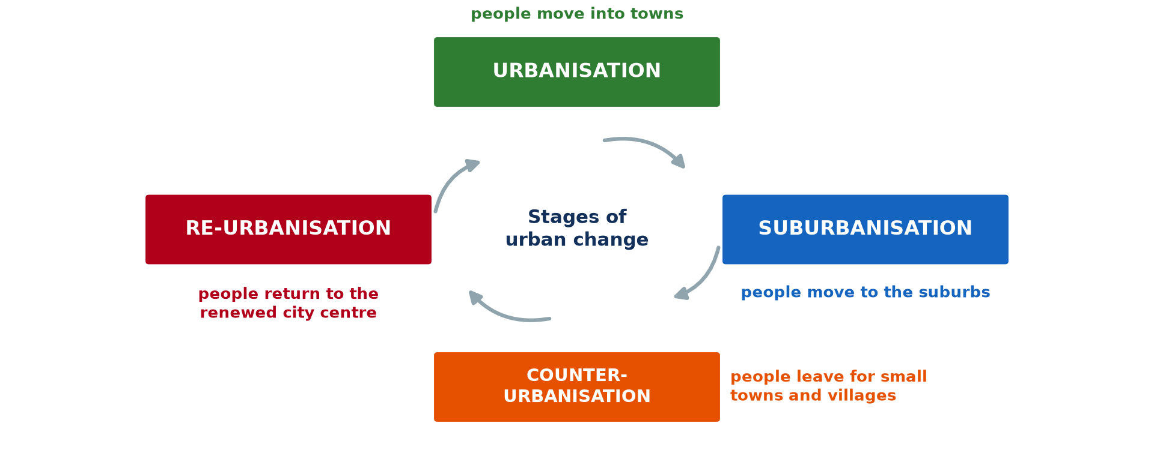
GEOGRAPHY — UPPER SIXTH ARTS
I. STAGES
Activity 1
Stages of urban change.
2026 / 2027
DGCAST GAROUA — GEOGRAPHY DEPARTMENT
Mr KAMDEM E. | 14
Notes:
Without the projector: draw the cycle.

Slide 15
GEOGRAPHY — UPPER SIXTH ARTS
I. STAGES
Activity 1: Question
Name the four stages of urban change.
2026 / 2027
DGCAST GAROUA — GEOGRAPHY DEPARTMENT
Mr KAMDEM E. | 15

Slide 16
GEOGRAPHY — UPPER SIXTH ARTS
I. STAGES
Answer
Urbanisation, suburbanisation, counter-urbanisation, re-urbanisation.
2026 / 2027
DGCAST GAROUA — GEOGRAPHY DEPARTMENT
Mr KAMDEM E. | 16

Slide 17

GEOGRAPHY — UPPER SIXTH ARTS
II. SUBURBANISATION
Activity 2
Suburbs from the air (Chicago).
2026 / 2027
DGCAST GAROUA — GEOGRAPHY DEPARTMENT
Mr KAMDEM E. | 17
Notes:
Without the projector: discuss new quarters.

Slide 18
GEOGRAPHY — UPPER SIXTH ARTS
II. SUBURBANISATION
Activity 2: Question
Give two causes of suburbanisation.
2026 / 2027
DGCAST GAROUA — GEOGRAPHY DEPARTMENT
Mr KAMDEM E. | 18

Slide 19
GEOGRAPHY — UPPER SIXTH ARTS
II. SUBURBANISATION
Answer
Cars and better roads, and the wish for space and quiet.
2026 / 2027
DGCAST GAROUA — GEOGRAPHY DEPARTMENT
Mr KAMDEM E. | 19

Slide 20

GEOGRAPHY — UPPER SIXTH ARTS
III. COUNTER-URBANISATION
Activity 3
Countryside with farms.
2026 / 2027
DGCAST GAROUA — GEOGRAPHY DEPARTMENT
Mr KAMDEM E. | 20
Notes:
Without the projector: discuss retirees going home.

Slide 21
GEOGRAPHY — UPPER SIXTH ARTS
III. COUNTER-URBANISATION
Activity 3: Question
Why do some city people move to the countryside?
2026 / 2027
DGCAST GAROUA — GEOGRAPHY DEPARTMENT
Mr KAMDEM E. | 21

Slide 22
GEOGRAPHY — UPPER SIXTH ARTS
III. COUNTER-URBANISATION
Answer
For quiet, clean air and cheaper houses; working from home.
2026 / 2027
DGCAST GAROUA — GEOGRAPHY DEPARTMENT
Mr KAMDEM E. | 22

Slide 23
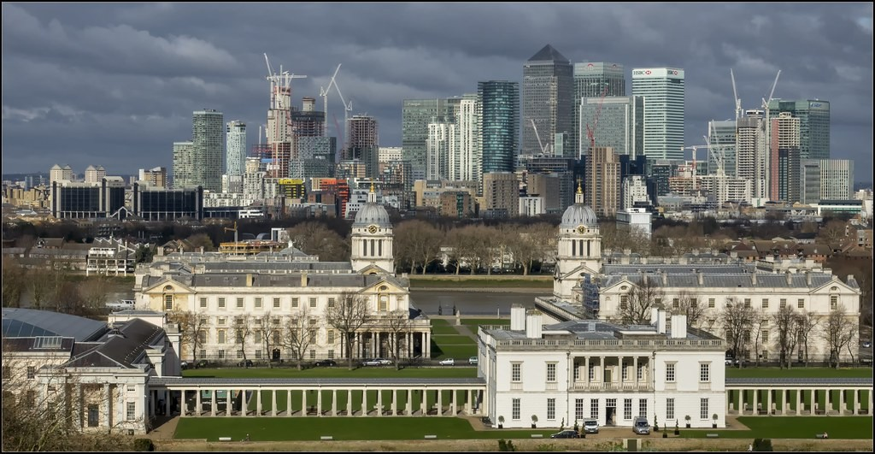
GEOGRAPHY — UPPER SIXTH ARTS
IV. RE-URBANISATION
Activity 4
Old and new buildings: London Docklands.
2026 / 2027
DGCAST GAROUA — GEOGRAPHY DEPARTMENT
Mr KAMDEM E. | 23
Notes:
Without the projector: describe renewal.

Slide 24
GEOGRAPHY — UPPER SIXTH ARTS
IV. RE-URBANISATION
Activity 4: Question
What attracts people back to the city centre?
2026 / 2027
DGCAST GAROUA — GEOGRAPHY DEPARTMENT
Mr KAMDEM E. | 24

Slide 25
GEOGRAPHY — UPPER SIXTH ARTS
IV. RE-URBANISATION
Answer
Renewed housing, jobs and services close by.
2026 / 2027
DGCAST GAROUA — GEOGRAPHY DEPARTMENT
Mr KAMDEM E. | 25

Slide 26
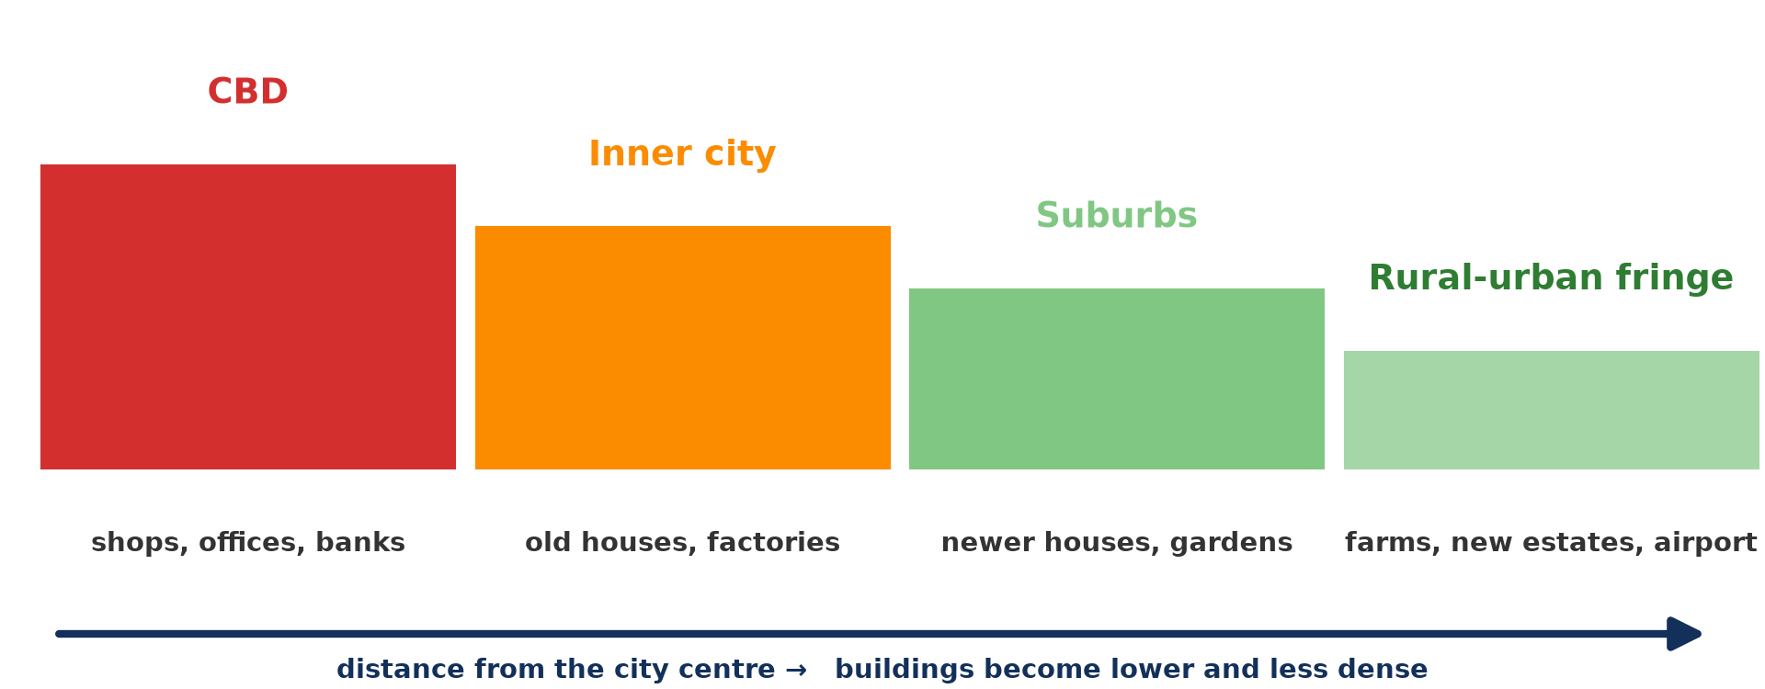
GEOGRAPHY — UPPER SIXTH ARTS
V. FORCES
Activity 5
Zones of the city.
2026 / 2027
DGCAST GAROUA — GEOGRAPHY DEPARTMENT
Mr KAMDEM E. | 26
Notes:
Without the projector: list each force.

Slide 27
GEOGRAPHY — UPPER SIXTH ARTS
V. FORCES
Activity 5: Question
Distinguish centripetal and centrifugal forces.
2026 / 2027
DGCAST GAROUA — GEOGRAPHY DEPARTMENT
Mr KAMDEM E. | 27

Slide 28
GEOGRAPHY — UPPER SIXTH ARTS
V. FORCES
Answer
Centripetal forces pull people to the centre; centrifugal forces push them out.
2026 / 2027
DGCAST GAROUA — GEOGRAPHY DEPARTMENT
Mr KAMDEM E. | 28

Slide 29
GEOGRAPHY — UPPER SIXTH ARTS
BOARD SUMMARY
Current Trends in Urbanisation
Topic: Urban Settlement and Urbanisation
Sub-topic: Urbanisation
Lesson 12: Current Trends in Urbanisation
2026 / 2027
DGCAST GAROUA — GEOGRAPHY DEPARTMENT
Mr KAMDEM E. | 29
Notes:
Learners copy the board summary now. Give them enough time for each slide.

Slide 30
GEOGRAPHY — UPPER SIXTH ARTS
BOARD SUMMARY
I. Definitions
Suburbanisation: It is the movement of people and activities from the centre to the suburbs.
Counter-urbanisation: It is the movement of people from cities to small towns and villages.
Re-urbanisation: It is the movement of people back into city centres.
2026 / 2027
DGCAST GAROUA — GEOGRAPHY DEPARTMENT
Mr KAMDEM E. | 30

Slide 31
GEOGRAPHY — UPPER SIXTH ARTS
BOARD SUMMARY
II. Trends (1/2)
A. Suburbanisation: Cars, roads and cheaper land pull people outward. The suburbs grow and the centre may decline.
B. Counter-urbanisation: Pollution, crime and costs push people away from cities. Phones and the internet allow work from home.
2026 / 2027
DGCAST GAROUA — GEOGRAPHY DEPARTMENT
Mr KAMDEM E. | 31

Slide 32
GEOGRAPHY — UPPER SIXTH ARTS
BOARD SUMMARY
II. Trends (2/2)
C. Re-urbanisation: Urban renewal makes centres attractive again. Young professionals move in (gentrification).
2026 / 2027
DGCAST GAROUA — GEOGRAPHY DEPARTMENT
Mr KAMDEM E. | 32

Slide 33
GEOGRAPHY — UPPER SIXTH ARTS
BOARD SUMMARY
III. Forces (1/2)
A. Centripetal forces: Jobs, services and accessibility pull people to the centre. They cause urbanisation and re-urbanisation.
B. Centrifugal forces: High land prices, congestion and pollution push people out. They cause suburbanisation and counter-urbanisation.
2026 / 2027
DGCAST GAROUA — GEOGRAPHY DEPARTMENT
Mr KAMDEM E. | 33

Slide 34
GEOGRAPHY — UPPER SIXTH ARTS
BOARD SUMMARY
III. Forces (2/2)
Copy the cycle.
2026 / 2027
DGCAST GAROUA — GEOGRAPHY DEPARTMENT
Mr KAMDEM E. | 34

Slide 35
GEOGRAPHY — UPPER SIXTH ARTS
FORMATIVE EVALUATION
Formative Evaluation 1
Define counter-urbanisation.
2026 / 2027
DGCAST GAROUA — GEOGRAPHY DEPARTMENT
Mr KAMDEM E. | 35

Slide 36
GEOGRAPHY — UPPER SIXTH ARTS
FORMATIVE EVALUATION
Expected Answer
The movement of people from cities to small towns and villages.
2026 / 2027
DGCAST GAROUA — GEOGRAPHY DEPARTMENT
Mr KAMDEM E. | 36

Slide 37
GEOGRAPHY — UPPER SIXTH ARTS
FORMATIVE EVALUATION
Formative Evaluation 2
Give one centripetal and one centrifugal force.
2026 / 2027
DGCAST GAROUA — GEOGRAPHY DEPARTMENT
Mr KAMDEM E. | 37

Slide 38
GEOGRAPHY — UPPER SIXTH ARTS
FORMATIVE EVALUATION
Expected Answer
Centripetal: jobs in the centre. Centrifugal: high land prices.
2026 / 2027
DGCAST GAROUA — GEOGRAPHY DEPARTMENT
Mr KAMDEM E. | 38

Slide 39
GEOGRAPHY — UPPER SIXTH ARTS
REMEDIATION
Remediation
Fill in the blanks:
Movement to the suburbs is ______.
Movement back to the centre is ______.
Forces pushing people outward are ______.
2026 / 2027
DGCAST GAROUA — GEOGRAPHY DEPARTMENT
Mr KAMDEM E. | 39
Notes:
Answers: 1. suburbanisation 2. re-urbanisation 3. centrifugal

Slide 40
GEOGRAPHY — UPPER SIXTH ARTS
HOMEWORK
Homework
Which of the four stages is happening in your town? Give evidence.
This prepares Lesson 13: Urban Regions.
2026 / 2027
DGCAST GAROUA — GEOGRAPHY DEPARTMENT
Mr KAMDEM E. | 40
Notes:
This homework prepares the next lesson.

Slide 41
GEOGRAPHY — UPPER SIXTH ARTS
BILINGUAL GAME
Bilingual Game (Jeu Bilingue)
English | Français
Suburb | La banlieue
Suburbanisation | La périurbanisation
Counter-urbanisation | La contre-urbanisation
Gentrification | La gentrification
Centre | Le centre-ville
Force | La force
2026 / 2027
DGCAST GAROUA — GEOGRAPHY DEPARTMENT
Mr KAMDEM E. | 41
Notes:
Say the English word; learners give the French word, then the reverse.

Slide 42
GEOGRAPHY — UPPER SIXTH ARTS
LOGBOOK
Official Logbook (1/2)
Module / Topic | Urban Settlement and Urbanisation
Lesson Title | Lesson 12: Current Trends in Urbanisation
Expected Learning Outcomes | Explain suburbanisation. Explain counter-urbanisation. Explain re-urbanisation and centripetal and centrifugal forces.
Competence | Learners are able to explain the recent stages of urban change.
2026 / 2027
DGCAST GAROUA — GEOGRAPHY DEPARTMENT
Mr KAMDEM E. | 42

Slide 43
GEOGRAPHY — UPPER SIXTH ARTS
LOGBOOK
Official Logbook (2/2)
Matter Taught | I. Definitions: Suburbanisation, Counter-urbanisation, Re-urbanisation; II. Trends: Suburbanisation, Counter-urbanisation, Re-urbanisation; III. Forces: Centripetal forces, Centrifugal forces.
Evaluation | Formative evaluation (3 questions) and remediation exercise.
Homework | Which of the four stages is happening in your town? Give evidence.
Enrolment / Present / Absent | ____ / ____ / ____
Achievement | To be completed by the teacher after the lesson.
2026 / 2027
DGCAST GAROUA — GEOGRAPHY DEPARTMENT
Mr KAMDEM E. | 43

Slide 44
GEOGRAPHY — UPPER SIXTH ARTS
TEACHER'S NOTE
Teacher's Note
Timing: Set-up, recall 8 min | Situation 8 min | 5 activities 30 min | Board summary (copying) 30 min | Evaluation, remediation 10 min | Homework, logbook 9 min | Spare 5 min
2026 / 2027
DGCAST GAROUA — GEOGRAPHY DEPARTMENT
Mr KAMDEM E. | 44

Slide 45
GEOGRAPHY — UPPER SIXTH ARTS
REFERENCES
References
National Geography Syllabus, Sixth Forms (Lower & Upper Sixth), MINESEC/IGE/IP-SS, August 2019 — Module 5 (Settlement Geography).
Photo, Activity 2: “Chicago suburbs from the air” by Scorpions and Centaurs, CC BY-NC-SA 2.0, via Flickr (https://www.flickr.com/photos/62736719@N00/2912708983)
Photo, Activity 3: “Timid” by tricky (rick harrison), CC BY-NC-SA 2.0, via Flickr (https://www.flickr.com/photos/81851211@N00/205287304)
Photo, Activity 4: “Old & new: University Greenwich, The Queen's House & London Docklands” by Bert Kaufmann, CC BY-NC 2.0, via Flickr (https://www.flickr.com/photos/22746515@N02/26742366958)
Diagrams and animations: drawn for this lesson (DGCAST Geography Department).
2026 / 2027
DGCAST GAROUA — GEOGRAPHY DEPARTMENT
Mr KAMDEM E. | 45

